Slide 1
LabB: Convolution
Name: 吳泓毅
Student ID: R11922029
Department NTU CSIE
Github: https://github.com/Anderson-Wu/AAHLS_LAB_B

Slide 2
Outline
Introduction to Convolution
Goal of This Lab
Performance Requirement of 1080 HD Video
Software Implementation and Estimation
Hardware Estimation
Hardware Implementation
Host Optimization
Host Program
Performance Analysis
Summary
Question

Slide 3
Outline
Introduction to Convolution
Convolution Filter
Process of Filtering
Goal of This Lab
Performance Requirement of 1080 HD Video
Software Implementation and Estimation
Hardware Estimation
Hardware Implementation
Host Optimization
Host Program
Performance Analysis
Summary
Question

Slide 4
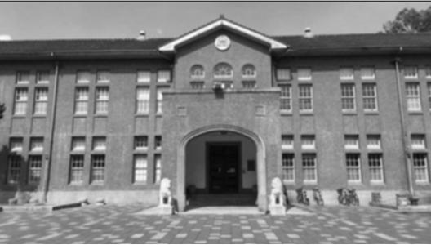
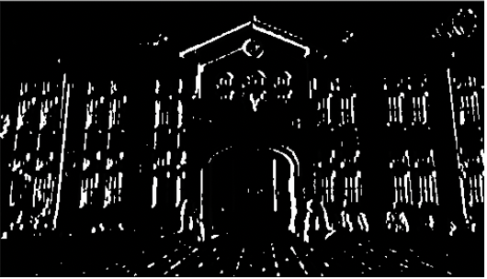
Introduction to Convolution - Convolution Filter
A matrix of coefficients
Different filter has different application.(e.g., filter noise, manipulate motion blur, enhance color and contrast, edge detection, etc.
1 | 0 | -1
2 | 0 | -2
1 | 0 | -1
*
=
Input Image
Sobel x filter
Vertical Edge

Slide 5
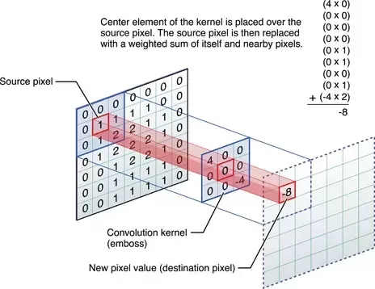

Introduction to Convolution - Process of Filtering
Steps
Selecting an input pixel as highlighted in red box in the figure below
Extracting a sub-matrix whose size is the same as filter coefficients
Calculating element-wise sum-of-product of extracted sub-matrix and coefficients matrix
Placing the sum-of-product as output pixel in output image/frame on the same index as the input pixel

Slide 6
Outline
Introduction to Convolution
Goal of This Lab
Performance Requirement of 1080 HD Video
Software Implementation and Estimation
Hardware Estimation
Hardware Implementation
Host Optimization
Host Program
Performance Analysis
Summary
Question

Slide 7

Goal of This Lab
Process convolution operation on 1080p HD Video and get 60 FPS

Slide 8
Outline
Introduction to Convolution
Goal of This Lab
Performance Requirement of 1080 HD Video
Software Implementation and Estimation
Hardware Estimation
Hardware Implementation
Host Optimization
Host Program
Performance Analysis
Summary
Question

Slide 9
Performance Requirement of 1080 HD Video
Video Resolution: 1920 x 1080
Frame Width (pixels): 1920
Frame Height (pixels): 1080
Frame Rate(FPS): 60
Pixel Depth(Bits): 8
Color Channels(YUV): 3
Throughput(Pixel/s): Frame Width x Frame Height x Channels x FPS
Throughput(Pixel/s): 1920x1080x3x60
Throughput (MB/s): 373 MB/s

Slide 10
Outline
Introduction to Convolution
Goal of This Lab
Performance Requirement of 1080 HD Video
Software Implementation and Estimation
Convolution Operation Function
Top-Level Function
Result
Hardware Estimation
Hardware Implementation
Host Optimization
Host Program
Performance Analysis
Summary
Question

Slide 11
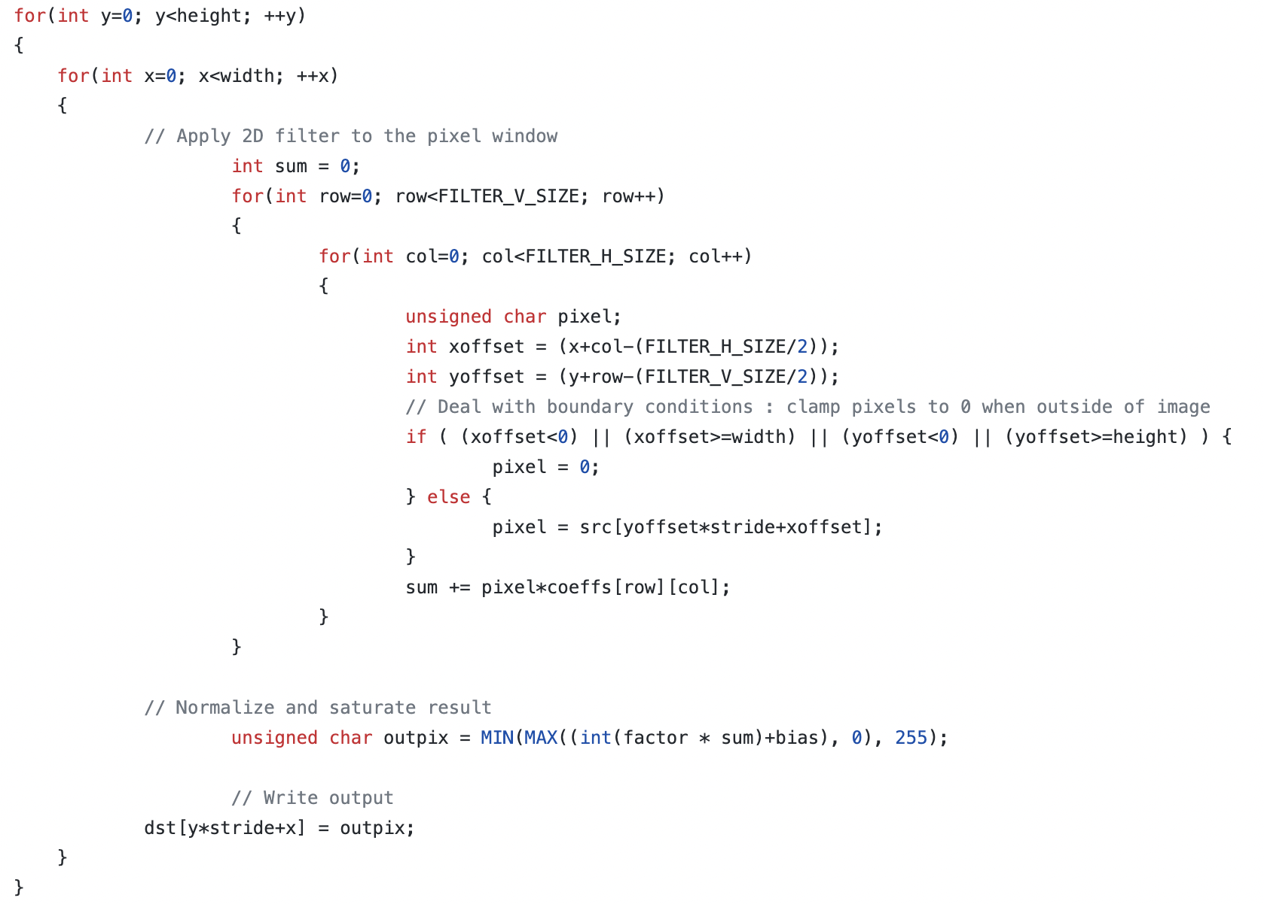
Software Implementation – Convolution Operation Function
Outer two loops: Define the pixel to be processed
Inner two loops: Perform the sum of product operation

Slide 12
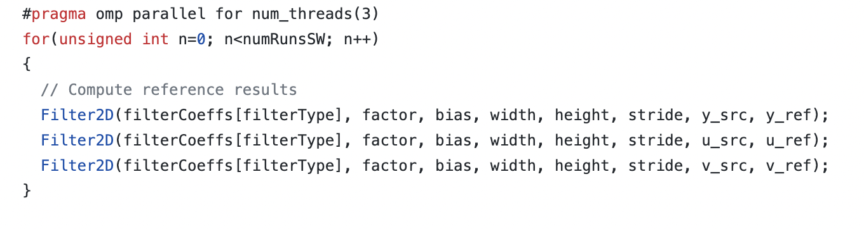
Software Implementation – Top-Level Function
Top-level function calls the convolution filter function for an image with three components or channels.
OpenMP pragma is used to parallelize software execution using multiple threads.

Slide 13
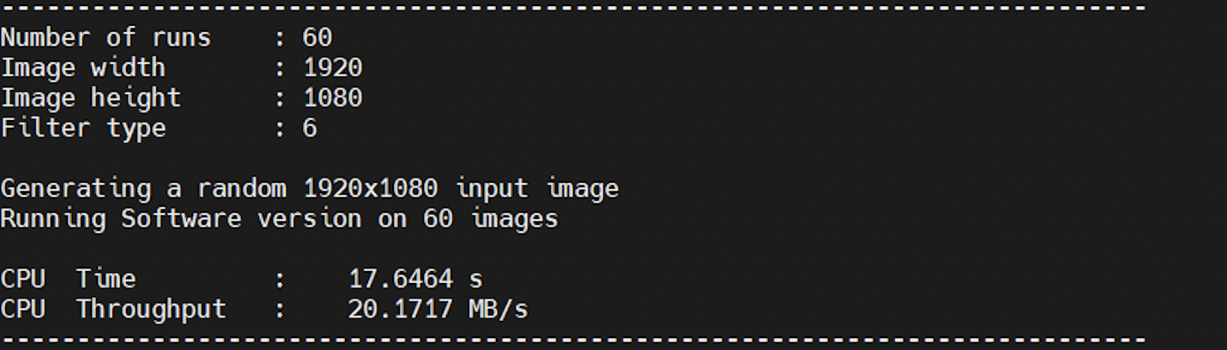
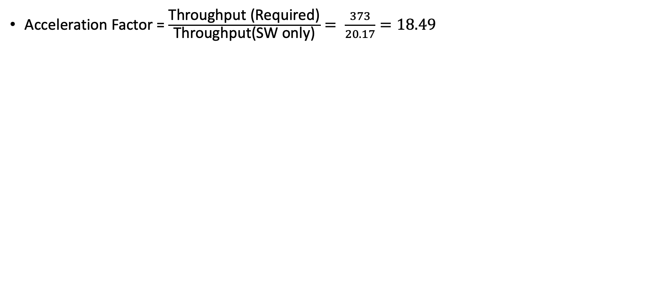

Software Implementation – Result
Acceleration Factor = $\frac{\text{Throughput}\text{ (}\text{Required}\text{)}}{\text{Throughput}\text{(}\text{SW} \text{only}\text{)}}= \frac{373}{20.17}=18.49$

Slide 14
Outline
Introduction to Convolution
Goal of This Lab
Performance Requirement of 1080 HD Video
Software Implementation and Estimation
Hardware Estimation
Observation
Baseline Performance
Optimized Performance (unroll loop)
Optimized Performance (compute units)
Hardware Implementation
Host Optimization
Host Program
Performance Analysis
Summary
Question

Slide 15
Hardware Implementation – Observation
The core compute is done in a 4-level nested loop, but you can break it to the compute per output pixel produced.
In terms of the output-pixels produced, it is clear from the filter source code that a single output pixel is produced when the inner two loops finish execution once.
These two loops are essentially doing the sum-of-product on a coefficient matrix and image submatrix. The matrix sizes are defined by the coefficient matrix, which is 15x15.
The inner two loops are performing a dot product of size 225(15x15). In other words, the two inner loops perform 225 multiply-accumulate (MAC) operations for every output pixel produced.

Slide 16
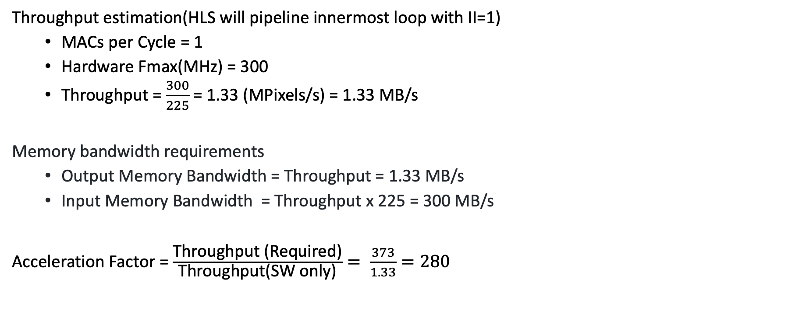
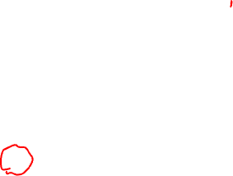
Hardware Implementation – Baseline Performance
Throughput estimation(HLS will pipeline innermost loop with II=1)
MACs per Cycle = 1
Hardware Fmax(MHz) = 300
Throughput = $\frac{300}{225}$ = 1.33 (MPixels/s) = 1.33 MB/s
Memory bandwidth requirements
Output Memory Bandwidth = Throughput = 1.33 MB/s
Input Memory Bandwidth = Throughput x 225 = 300 MB/s
Acceleration Factor = $\frac{\text{Throughput}\text{ (}\text{Required}\text{)}}{\text{Throughput}\text{(}\text{SW} \text{only}\text{)}}= \frac{373}{1.33}=280$

Slide 17
Hardware Implementation – Optimized Performance (unroll loop)
We can unroll inner two loops with pipeline to gain in performance by 225(15x15), which means a throughput of 1 output pixel per cycle.
Throughput estimation
Throughput = Fmax x Pixels produced per cycle = 300 x 1 = 300 MB/s
Memory bandwidth requirements
Output Memory Bandwidth = Fmax x Pixels produced per cycle = 300 MB/s
Input Memory Bandwidth = Fmax x Input pixels read per output pixel = 300 * 225 = 67.5 GB/s
The input memory bandwidth is too large. We can reduced bandwidth to around 300MB/s by using caching scheme since the convolution filter belongs to a class of kernels known as stencil kernels.

Slide 18
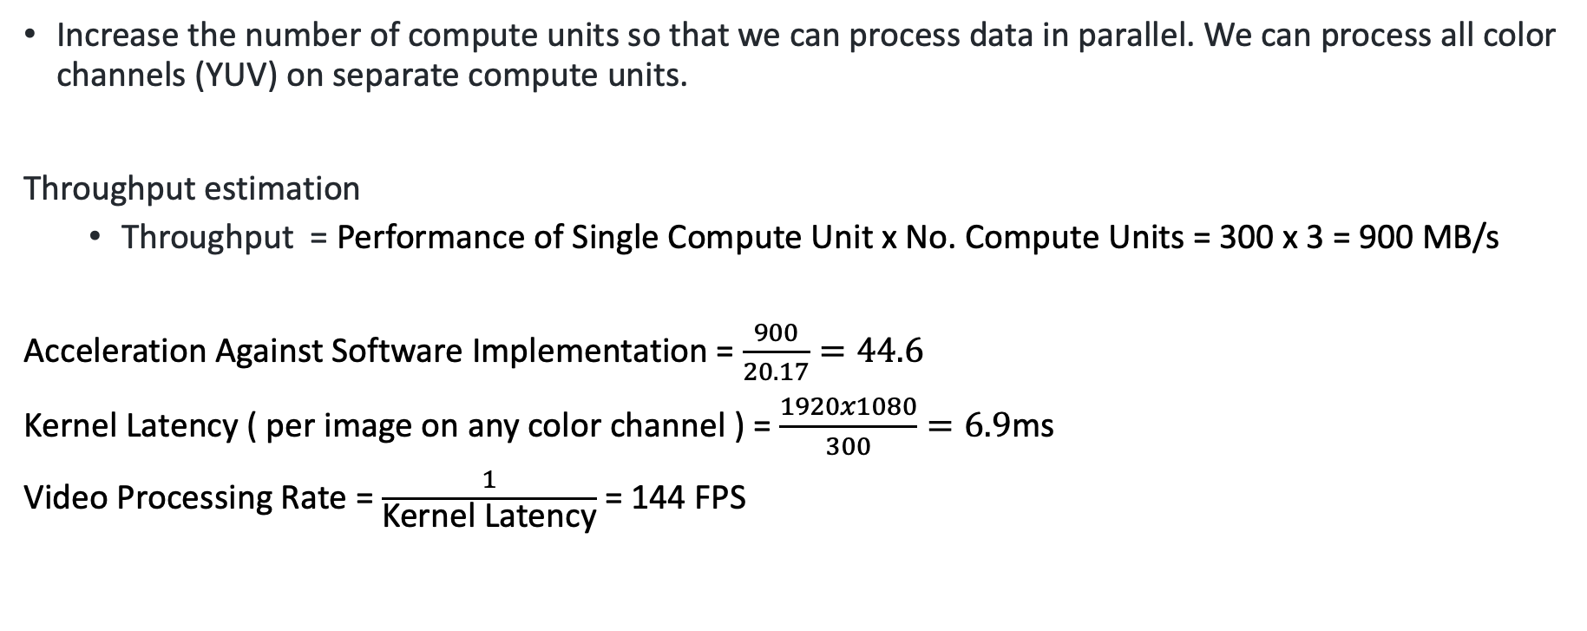

Hardware Implementation – Optimized Performance (compute units)
Increase the number of compute units so that we can process data in parallel. We can process all color channels (YUV) on separate compute units.
Throughput estimation
Throughput = Performance of Single Compute Unit x No. Compute Units = 300 x 3 = 900 MB/s
Acceleration Against Software Implementation = $\frac{900}{20.17}=44.6$
Kernel Latency ( per image on any color channel ) = $\frac{1920x1080}{300}=6.9$ms
Video Processing Rate = $\frac{1}{\text{Kernel} \text{Latency}}$ = 144 FPS

Slide 19
Outline
Introduction to Convolution
Goal of This Lab
Performance Requirement of 1080 HD Video
Software Implementation and Estimation
Hardware Estimation
Hardware Implementation
Functions in Dataflow
Top-Level Function
Function ReadFromMem
Function Window2D
Function Filter2D
Function WriteToMem
Host Optimization
Host Program
Performance Analysis
Summary
Question

Slide 20
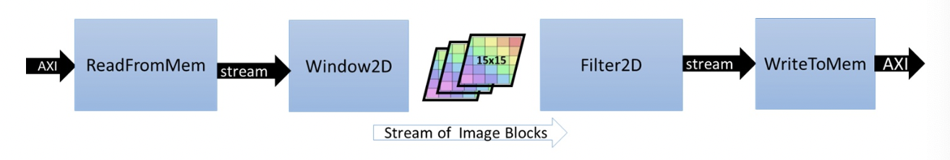

Hardware Implementation – Functions in Dataflow
ReadFromMem: reads pixel data or video input from main memory
Window2D: local cache with wide(15x15 pixels) access on the output side
Filter2D: core kennel filtering algorithm
WriteToMem: writes output data to main memory

Slide 21
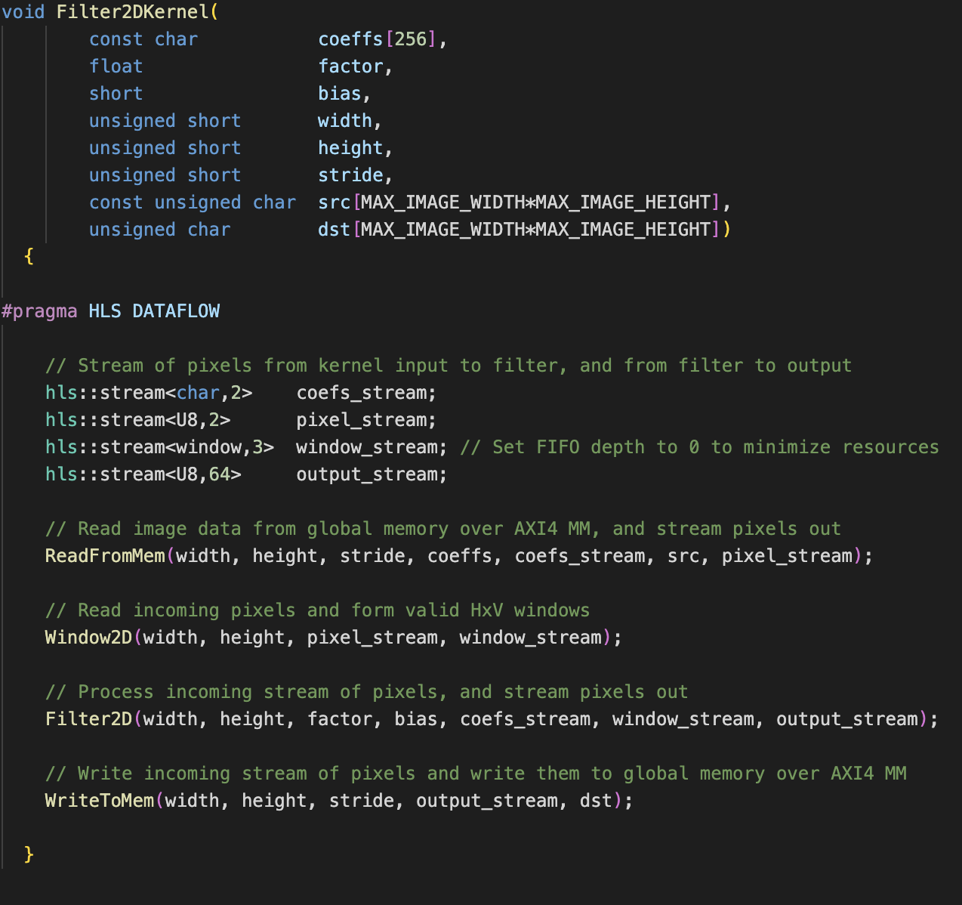
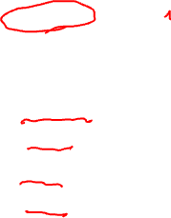
Hardware Implementation – Top-Level Function
#pragma HLS DATAFLOW
Use a dataflow process

Slide 22
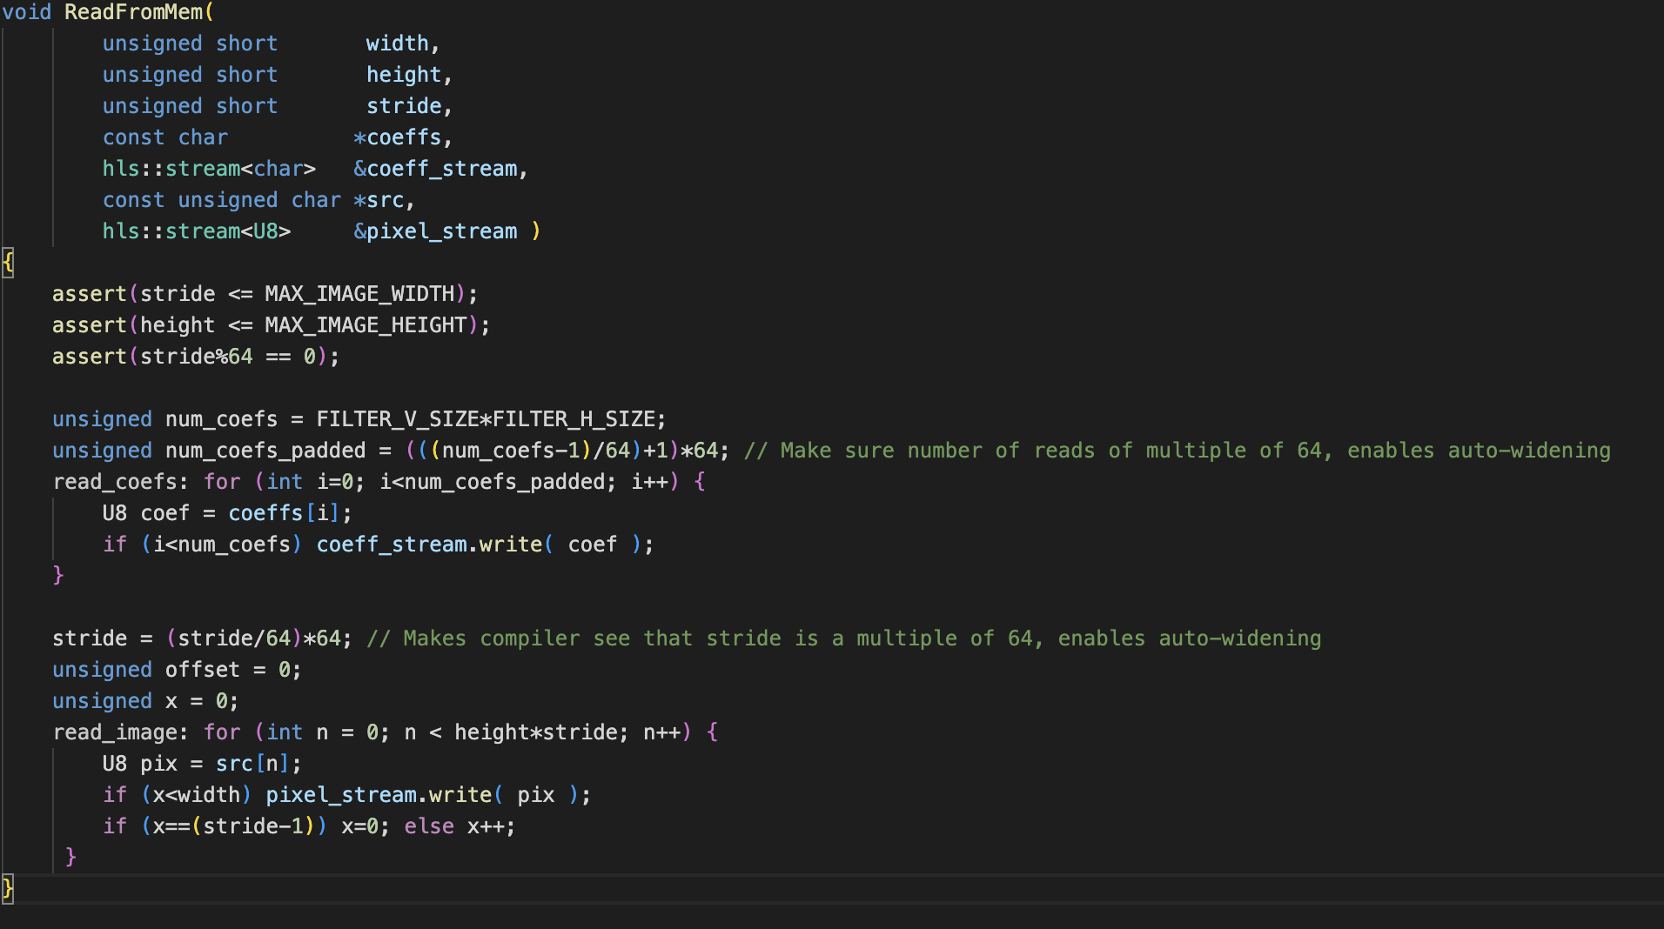

Hardware Implementation – Function ReadFromMem
Reads pixel data or video input from main memory

Slide 23
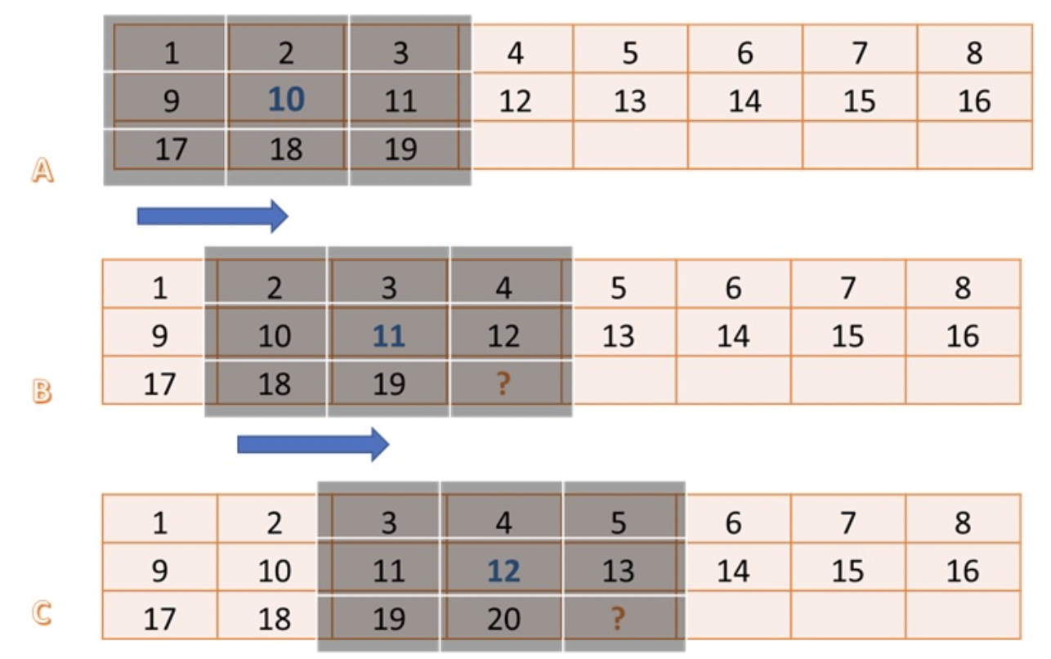

Hardware Implementation – Function Window2D
Built from two basic blocks: the first is called a ”Window", and the second is called a ”line buffer".

Slide 24
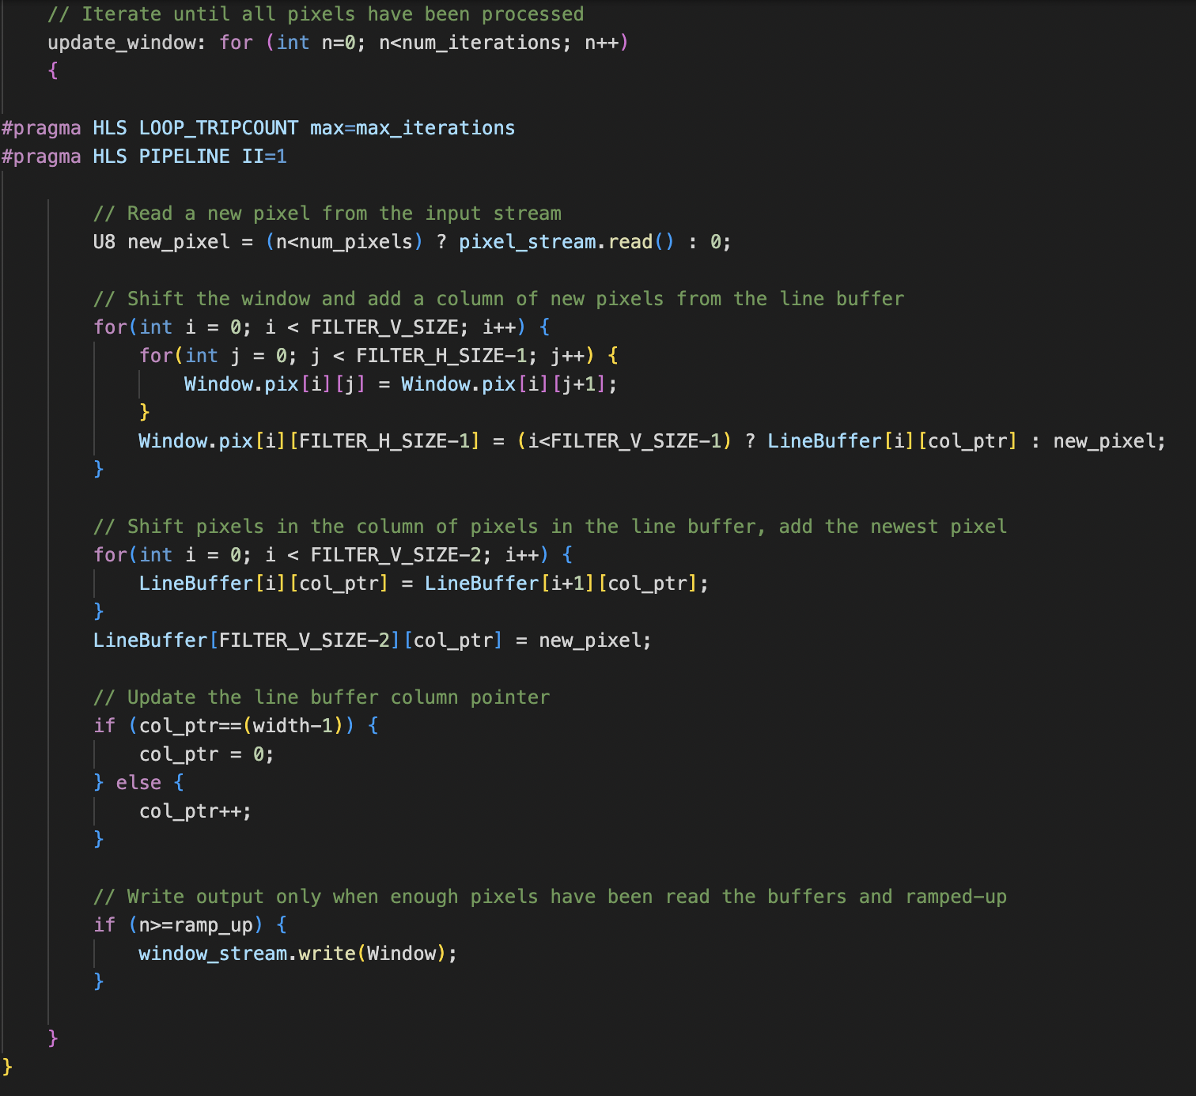
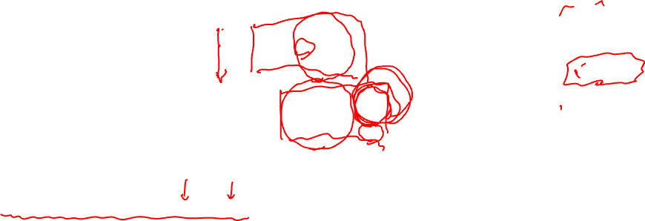
Hardware Implementation – Function Window2D - Window
Holds FILTER_V_SIZE x FILTER_H_SIZE pixels.
When we shift window 1 pixel, two columns will retain for the next operation, and the last column of pixels will come from line buffer and new input from function ReadFromMem. So for a new operation, we only need to get one more input by using caching method.
From line buffer
From last two columns of window A
From function ReadFromMem

Slide 25
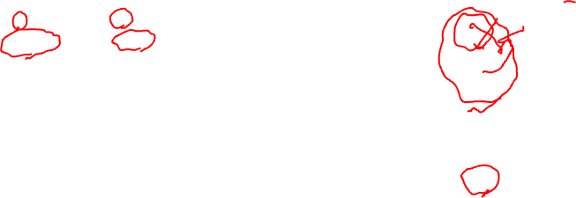
Hardware Implementation – Function Window2D – Line Buffer
Used to buffer FILTER_V_SIZE - 1 image lines. Where FILTER_V_SIZE is the height of the convolution filter. The total number of pixels held by the line buffer is (FILTER_V_SIZE-1) x MAX_IMAGE_WIDTH.
Line buffer before
9 | 10 | 11 | 4 | 5 | 6 | 7 | 8
17 | 18 | 19 | 12 | 13 | 14 | 15 | 16
Line buffer after
9 | 10 | 11 | 12 | 5 | 6 | 7 | 8
17 | 18 | 19 | 20 | 13 | 14 | 15 | 16
4 is removed since it will never be used, and 20(new input) is added to line buffer

Slide 26
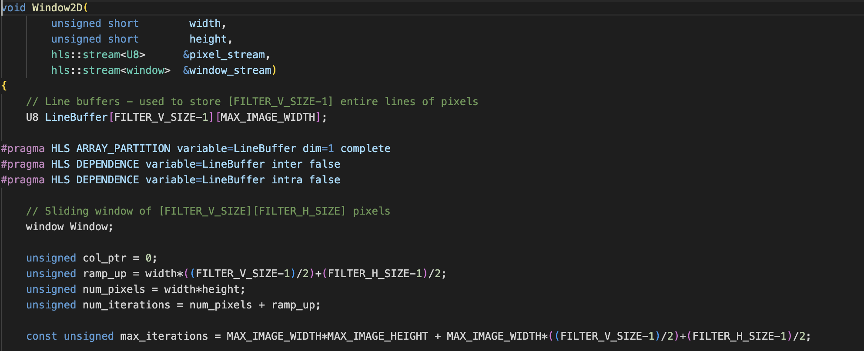
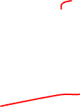
Hardware Implementation – Function Window2D – Code

Slide 27
Hardware Implementation – Function Window2D – Code Part1
#pragma HLS ARRAY_PARTITION variable=LineBuffer dim=1 complete
Full partition of LineBuffer on dimension 1
#pragma HLS DEPENDENCE variable=LineBuffer inter false
Tell HLS compiler that LineBuffer has no data dependency between two loops
#pragma HLS DEPENDENCE variable=LineBuffer intra false
Tell HLS compiler that LineBuffer has no data dependency in one loop

Slide 28
Hardware Implementation – Function Window2D – Code Part2
#pragma HLS LOOP_TRIPCOUNT max=max_iterations
Define max iterations of for loop, help for analysis
#pragma HLS PIPELINE II=1
Specifies the desired initiation interval in pipeline be 1

Slide 29
Hardware Implementation – Function Filter2D
Core kernel filtering algorithm
Get submatrix from function Window2D and coefficients matrix from function ReadFromMem

Slide 30
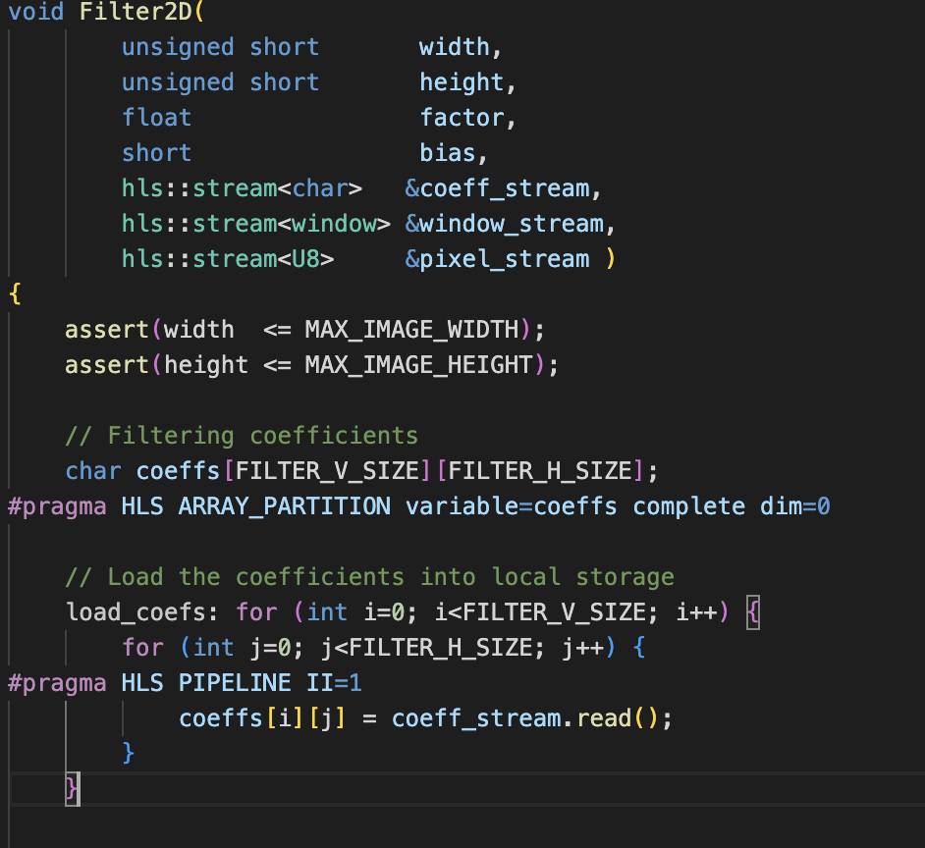
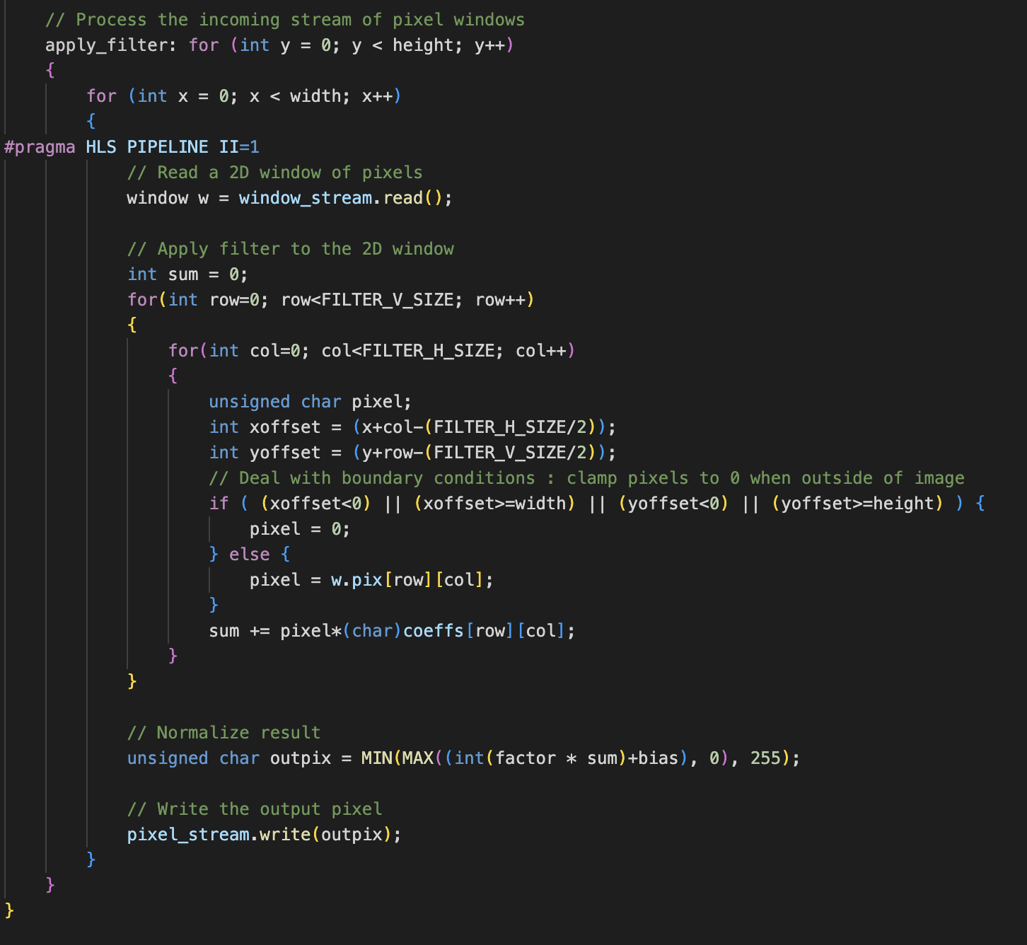

Hardware Implementation – Function Filter2D – Code

Slide 31
Hardware Implementation – Function Filter2D – Code Part1
#pragma HLS ARRAY_PARTITION variable=coeffs complete dim=0
Full partition coefficients array to meet convolution operation’s pipeline requirement
#pragma HLS PIPELINE II = 1
Specifies the desired initiation interval in pipeline be 1

Slide 32

Hardware Implementation – Function Filter2D – Code Part2
#pragma HLS PIPELINE II=1
Specifies the desired initiation interval in pipeline be 1
For loops under #pragma HLS PIPELINE are all be unrolled, and with II = 1, we can produce 1 pixel output per cycle

Slide 33
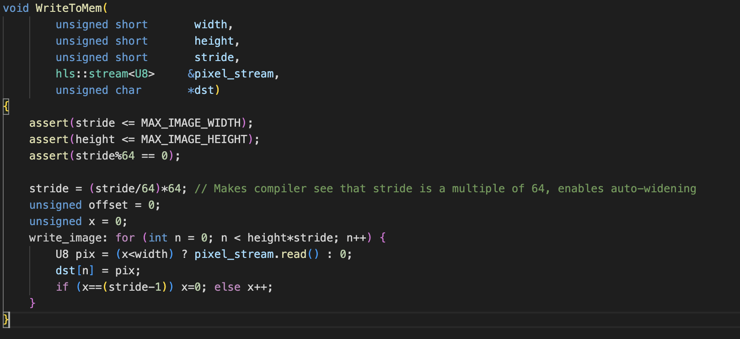
Hardware Implementation – Function WriteToMem
WriteToMem: writes output data to main memory

Slide 34
Outline
Introduction to Convolution
Goal of This Lab
Performance Requirement of 1080 HD Video
Software Implementation and Estimation
Hardware Estimation
Hardware Implementation
Host Optimization
Host Program
Performance Analysis
Summary
Question

Slide 35
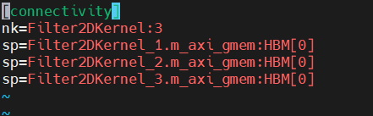
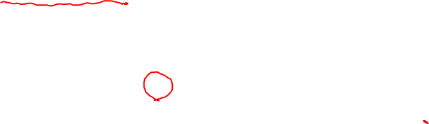
Host Optimization
In file krnl_build_options.cfg, we set the compute unit be three, so we can run three kernels at the same time.
Use outstanding requests to increase bus utilization and compute units utilization which means compute units always have data to execute.

Slide 36
Outline
Introduction to Convolution
Goal of This Lab
Performance Requirement of 1080 HD Video
Software Implementation and Estimation
Hardware Estimation
Hardware Implementation
Host Optimization
Host Program
Command Line Arguments
Main Function
Filter2DDispatcher Class
Filter2DRequest Class
Performance Analysis
Summary
Question

Slide 37
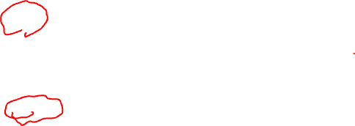
Host Program – Command Line Arguments
CmdLineParser parser;
parser.addSwitch("--nruns", "-n", "Number of times the image is processed", "1");
parser.addSwitch("--fpga", "-x", "FPGA binary (xclbin) file to use");
parser.addSwitch("--input", "-i", "Input image file");
parser.addSwitch("--filter", "-f", "Filter type (0-6)", "0");
parser.addSwitch("--maxreqs", "-r", "Maximum number of outstanding requests", "3");
parser.addSwitch("--compare", "-c", "Compare FPGA and SW performance", "false", true);
parser.addSwitch("--width", "-w", "Image width", "1920");
parser.addSwitch("--height", "-h", "Image height", "1080");

Slide 38
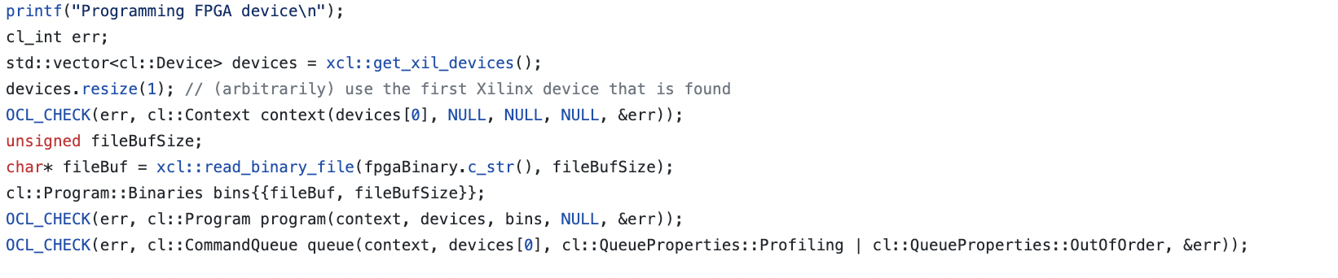

Host Program – Main Function
Get Xilinx device, create context, program, and command queue

Slide 39
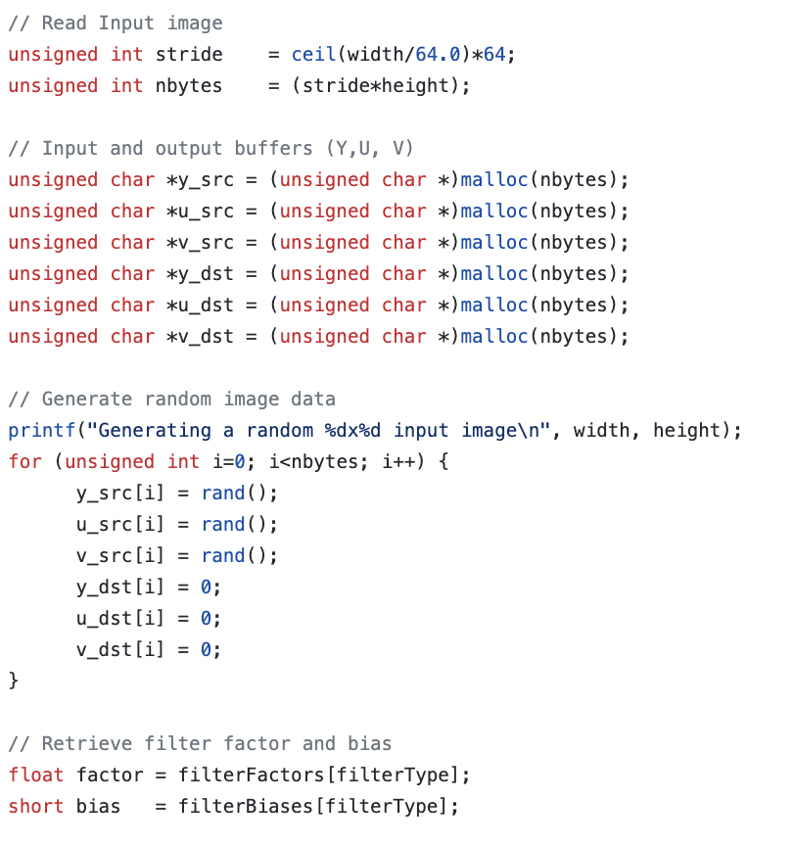

Host Program – Main Function
Create host memory and generate images
At this stage
Create host memory

Slide 40
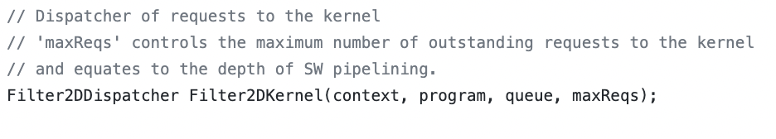
Host Program – Main Function
Create global memory and send part of kernel arguments
At this stage
Create Filter2DDispatcher object to handle request

Slide 41
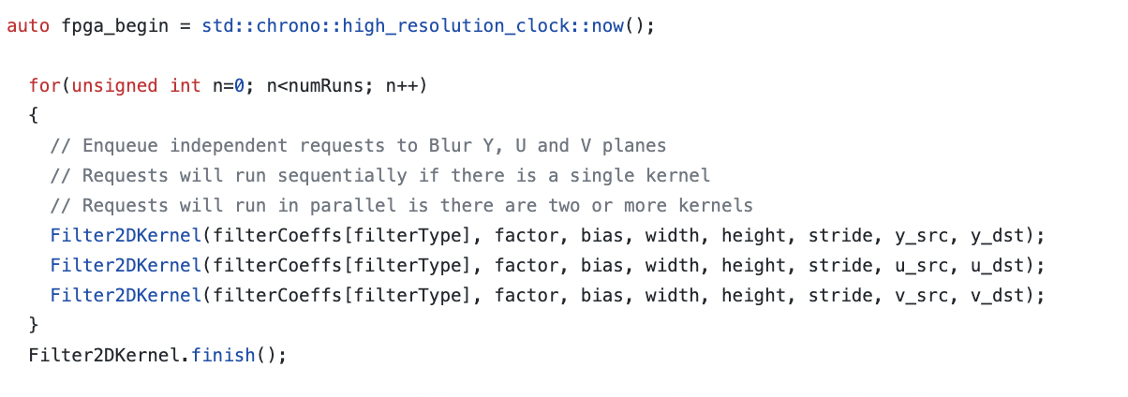

Host Program – Main Function
Set kernel arguments, transfer images, coefficients matrix from host memory to global memory, start kernel execution, and then get the result back to host memory
At this stage
Can run parallel since we have three compute units
Call Filter2D method in Filter2DRequest object to do kernel execution

Slide 42

Host Program – Filter2DDispatcher Class
The top-level class that provides an end-user API to schedule and manage kernel calls.
Holds a vector of Filter2DRequest objects. The number of request objects that are instantiated is defined as the max at construction time.
This parameter's minimum value can be as small as the number of compute units to allow at least one kernel enqueue call per compute unit to happen in parallel. But a larger value is desired since it will allow overlap between input and output data transfers happening between host and device.

Slide 43
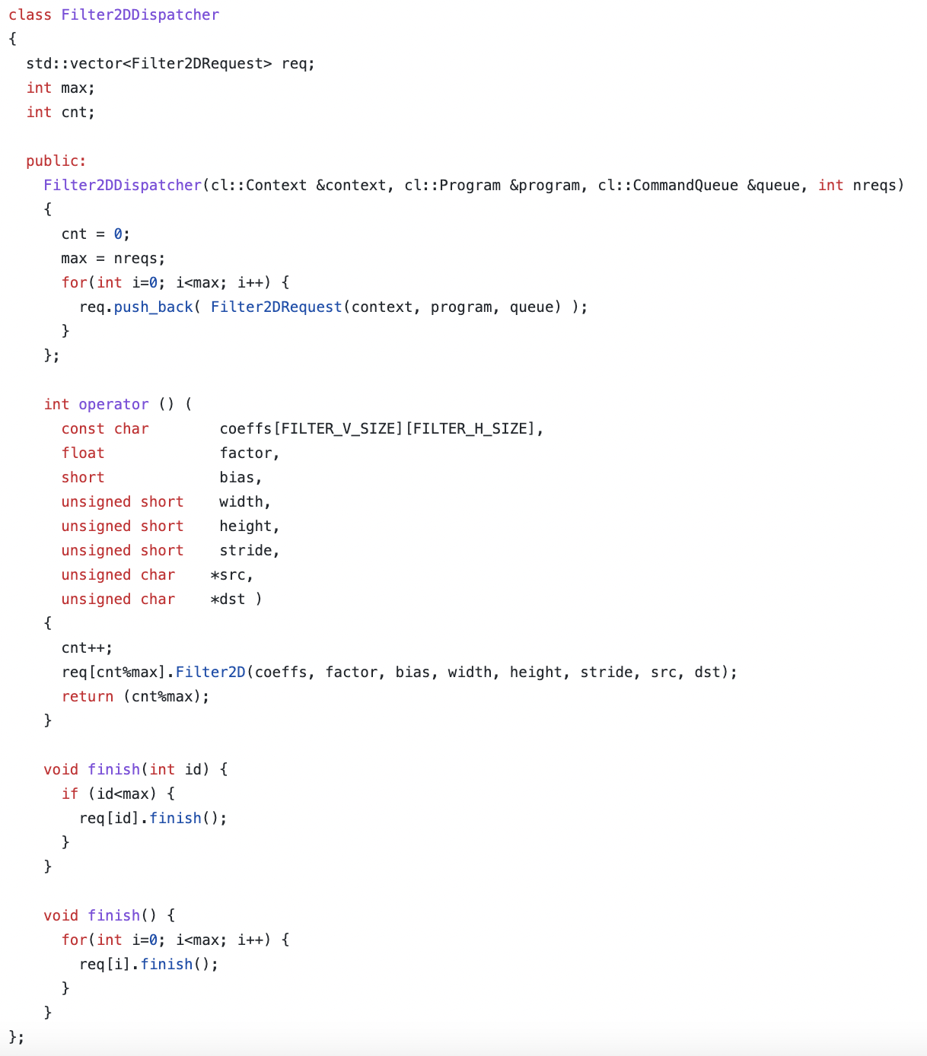

Host Program – Filter2DDispatcher - Code
Store all the requests
Constructor, create Filter2DRequest Objects
Call Filter2D method in Filter2DRequest object to do kernel execution

Slide 44
Host Program – Filter2DRequest Class
The Filter2DRequest class is used by Filter2DDispatcher class.
This class encapsulates a single request to process a single color channel (YUV) for a given image.
After an object of the Filter2DRequest class is created, it can be used to make a call to the Filter2D method. This call will enqueue all the operations, moving input data or filter coefficients, kernel calls, and reading of output data back to the host.

Slide 45
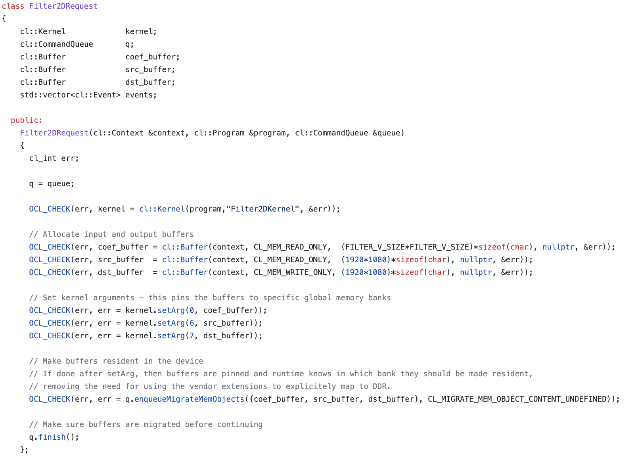
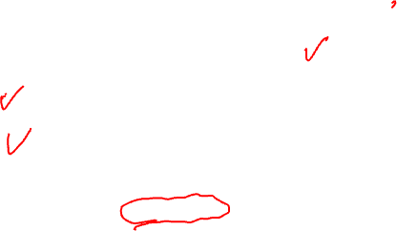
Host Program – Filter2DRequest – Code Part1
Constructor of Filter2DRequest
Create kernel
Create global memory
Set kernel arguments
Can be removed by experiment

Slide 46
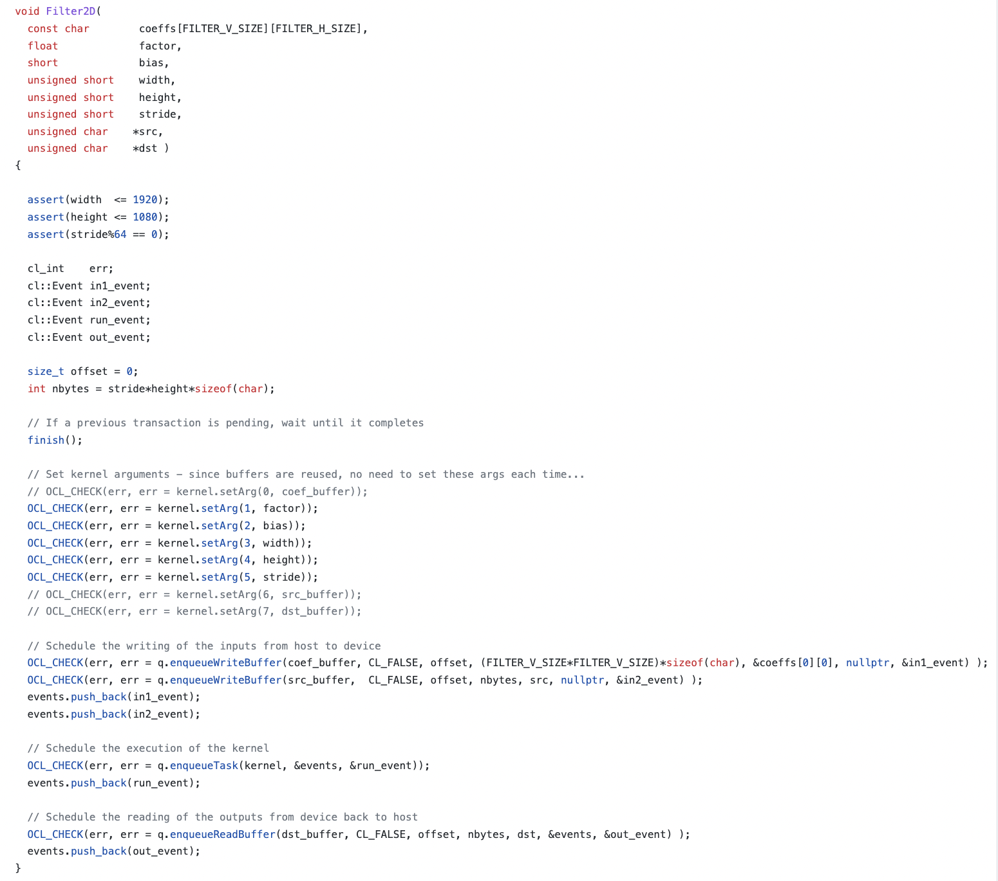

Host Program – Filter2DRequest – Code Part2
Filter2D method
Wait for previous request terminate
Set other kernel arguments
Transfer image and coefficients matrix from host to global memory
Enqueue task
Move result from global memory to host memory

Slide 47
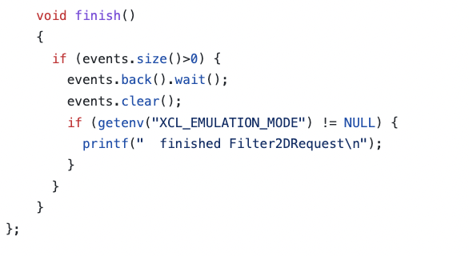
Host Program – Filter2DRequest – Code Part3
Finish method
Waiting for end of execution

Slide 48
Outline
Introduction to Convolution
Goal of This Lab
Performance Requirement of 1080 HD Video
Software Implementation and Estimation
Hardware Estimation
Hardware Implementation
Host Optimization
Host Program
Performance Analysis
Command to Run
Hardware Accelerated Result
Profile Summary
Application Timeline
Summary
Question

Slide 49
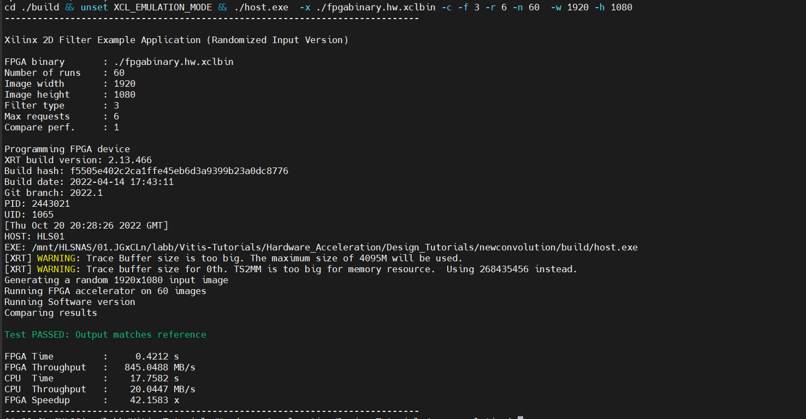

Performance Analysis – Command to Run
Set outstanding to 6 to increase compute units utilization.
number of outstanding is 6

Slide 50
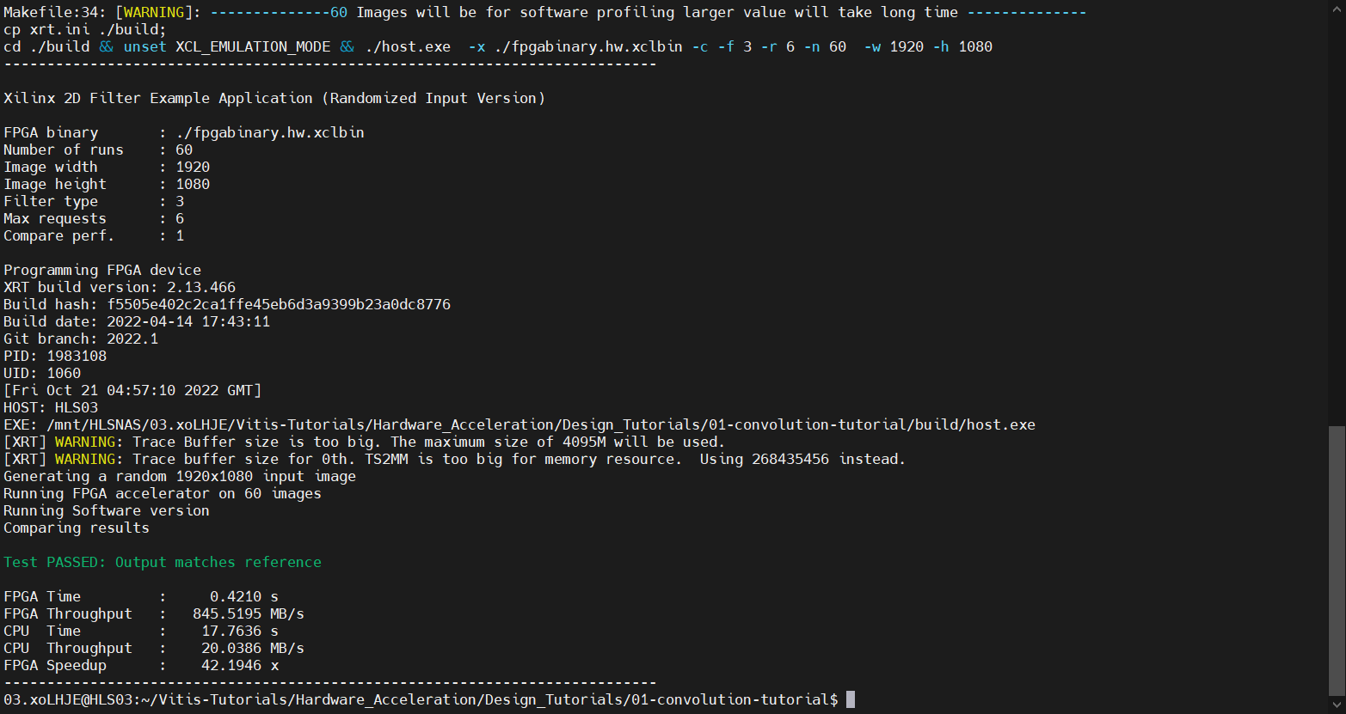
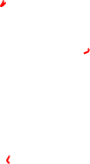
Performance Analysis - Hardware Accelerated Result
Meet the requirement 373MB/s

Slide 51
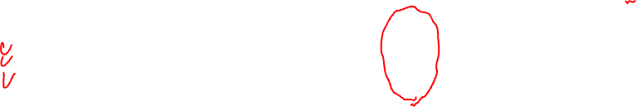
Performance Analysis – Profile Summary
From this table, it can be seen that the kernel compute time as displayed in the Avg Time column is about 7 ms, almost equal to the estimated kernel latency.
We can see that CU Device Utilization column, which is very close to 100 percent. This means the host was able to feed data to compute units through PCIe continuously. In other words, the host PICe bandwidth was sufficient, and compute units never saturated it.
We create three compute units in krnl_build_options.cfg

Slide 52
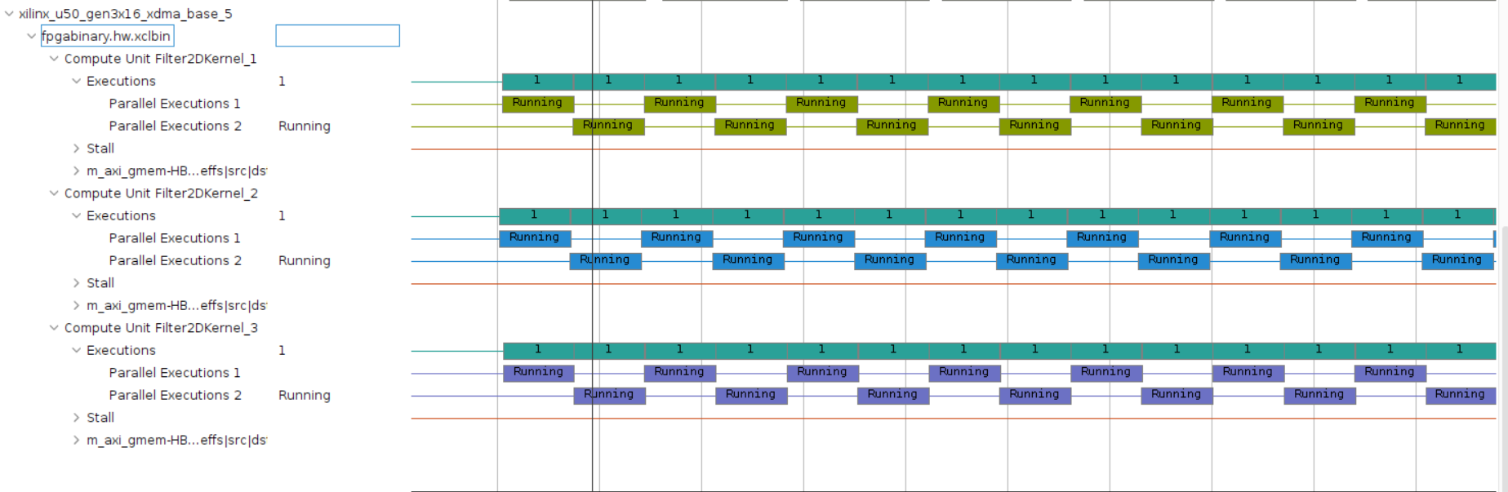
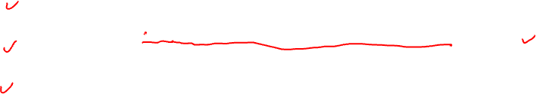
Performance Analysis – Application Timeline
We can also see that compute units can run almost all time due to outstanding request by seeing application timeline

Slide 53
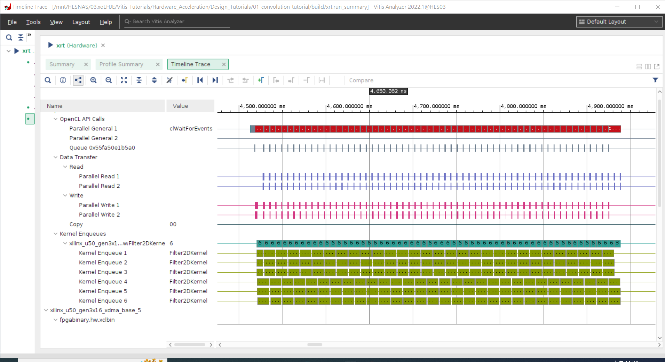
Performance Analysis – Application Timeline
It can be seen that the host read and write bandwidth is not fully utilized as there are gaps which means that only a fraction of host PCIe bandwidth is utilized.

Slide 54
Outline
Introduction to Convolution
Goal of This Lab
Performance Requirement of 1080 HD Video
Software Implementation and Estimation
Hardware Estimation
Hardware Implementation
Host Optimization
Host Program
Performance Analysis
Summary
Question

Slide 55
Summary
In this lab, We have learned:
How to build, run and analyze the performance of a video filter
How to write an optimized host-side application for multi CU designs
How to estimate kernel performance and compare it with measured performance

Slide 56
Outline
Introduction to Convolution
Goal of This Lab
Performance Requirement of 1080 HD Video
Software Implementation and Estimation
Hardware Estimation
Hardware Implementation
Host Optimization
Host Program
Performance Analysis
Summary
Question

Slide 57
Question
How many line buffers do we need when we have filter size of 5x5?

Slide 58
Question
How many line buffers do we need when we have filter size of 5x5?
Ans: 4

Slide 59
Question
Data transferred between host memory and global memory have latency which may let compute unit idle. How does this lab solve this problem to fully utilize kernel execution?

Slide 60
Question
Data transferred between host memory and global memory have latency which may let compute unit idle. How does this lab solve this problem to fully utilize kernel execution?
Ans: Using outstanding request

